Slide 1

Project Title -Seasonal Agriculture Performance Analysis
Student Name –Sanika Rajesh Whaval.
College Name- Anantrao Pawar College Of Engineering & Research.
AICTE STU ID :STU658d0fedee50d1703743469

Slide 2

PROBLEM STATEMENT
Agricultural activities are influenced by seasonal variations in environmental conditions, farming practices, resource availability and market conditions. As a result, agricultural performance may differ from one season to another. However, raw agricultural data does not clearly explain how agricultural performance changes across seasons or what patterns can be observed in different seasonal conditions. The problem is to analyze the given agricultural dataset and investigate seasonal differences in agricultural performance by identifying meaningful patterns, trends, relationships and variations within the available data.

Slide 3
Project Description This project focuses on analyzing agricultural activities across different seasons, geographical areas, crops, farming conditions, and resource usage. The dataset contains information related to farming practices, environmental conditions, crop production, resource utilization, and economic performance. The analysis involves cleaning and preparing the agricultural data, exploring seasonal variations, comparing agricultural performance across different categories, identifying relationships between environmental and agricultural factors, and applying statistical and visualization techniques to generate meaningful insights. The project aims to transform raw agricultural data into evidence-based insights and data-driven recommendations that can support better understanding and planning of seasonal agricultural activities. Key Areas Analyzed Seasonal performance Crop-wise yield Irrigation methods Water usage and efficiency Environmental conditions Resource utilization Economic performance Relationships between agricultural variables

Slide 4

WHO ARE THE END USERS?
End Users
The insights generated from this analysis can be useful for:
1. Farmers - To understand seasonal performance, crop yield patterns, irrigation requirements, and resource utilization.
2. Agricultural Planners - To compare seasonal performance and support evidence-based agricultural planning.
3. Agricultural Researchers - To study relationships between environmental conditions, farming practices, resources, and crop outcomes.
4. Government & Agricultural Departments - To understand regional and seasonal patterns that may support agricultural planning and resource management.
5. Agribusiness & Resource Managers - To evaluate production, resource efficiency, and economic performance for better decision-making.
These users align with the project's broader purpose of understanding seasonal variations, resource usage, performance differences, and supporting evidence-based planning.

Slide 5

Technology Used
Programming Language - Python
Data Analysis – Pandas , NumPy
Data Visualization - Matplotlib , Seaborn
Statistical Analysis - SciPy
Development Environment - Google Colab
Data Format - CSV
Techniques Applied - Data cleaning and preprocessing ,Descriptive statistics, Group-wise analysis ,Correlation analysis ,Statistical testing, Outlier analysis ,Data visualization ,Comparative analysis
The project brief specifically expects appropriate statistical

Slide 6
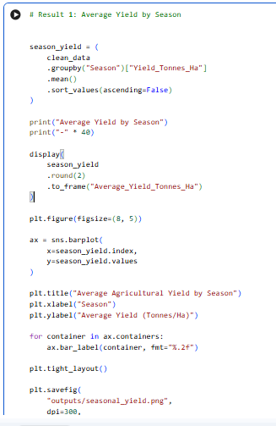
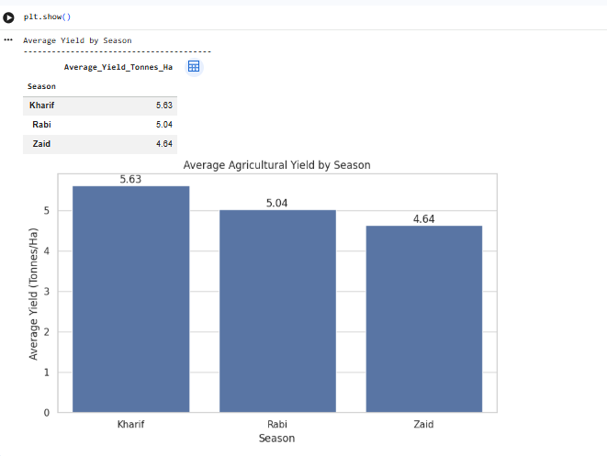
RESULTS
Insight
Kharif recorded the highest average agricultural yield, while Zaid recorded the lowest average yield among the three seasons.
This directly addresses the project's objective of examining how agricultural performance varies across seasons.

Slide 7
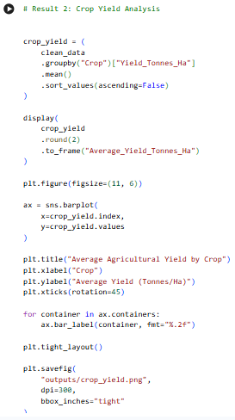
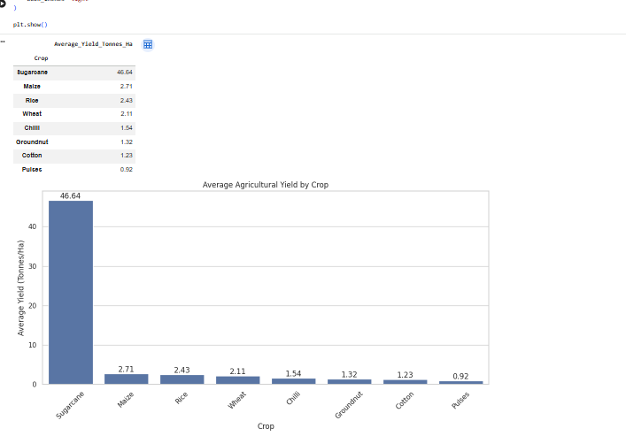
RESULTS
Insight - Crop-wise comparison helps identify differences in agricultural productivity and highlights crops with relatively higher production performance.
Yield varies considerably across crop types, with Sugarcane showing the highest average yield in the dataset at approximately 46.64 tonnes/ha.

Slide 8
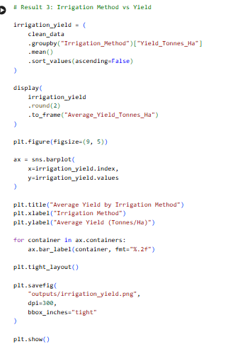
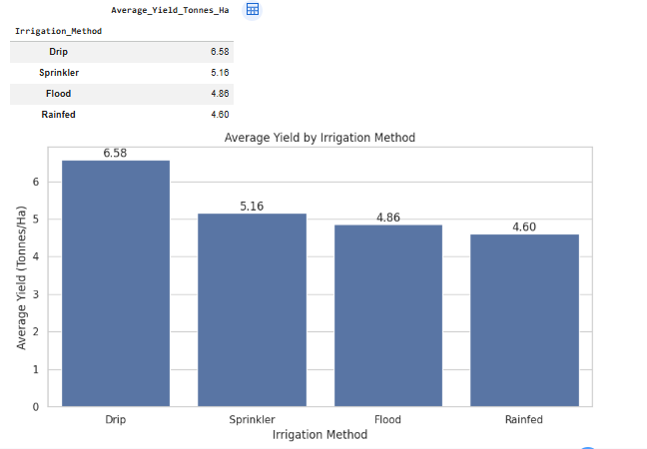
RESULTS
Insight -Drip irrigation recorded the highest average yield among the irrigation methods analyzed.
This indicates an observed association between irrigation method and yield within the available dataset.

Slide 9
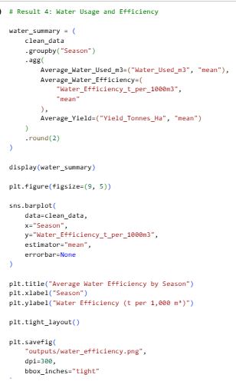
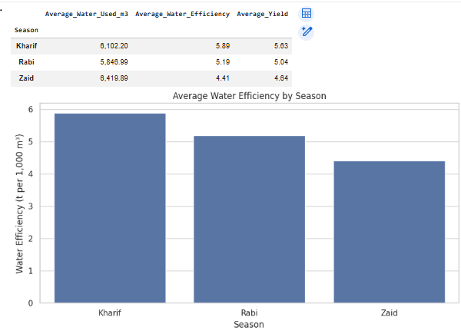
RESULTS
Insight - Kharif recorded the highest water-use efficiency, while Zaid recorded the lowest.
This analysis helps understand how resource utilization varies across seasons.

Slide 10
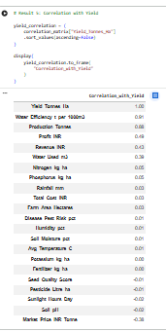
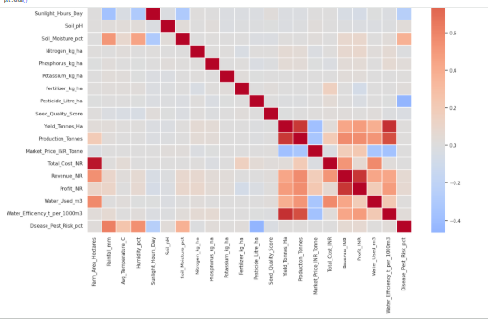
RESULTS
Insight
Water efficiency and production show the strongest positive relationships with yield in the dataset.

Slide 11
Future scope
The project can be further enhanced by:
Integrating real-time weather and environmental data.
Incorporating larger datasets covering multiple years and regions.
Developing predictive models for crop yield forecasting.
Using machine learning to identify factors associated with agricultural performance.
Developing an interactive Power BI/Tableau dashboard for easier decision-making.
Adding real-time monitoring of water usage, rainfall, soil conditions, and crop performance.
Developing a recommendation system to support seasonal crop and resource planning.
Future Vision
The analysis can be extended from descriptive analytics to predictive and
prescriptive analytics for more informed agricultural planning.

Slide 12
GitHub Link
https://github.com/sanika-whaval/Seasonal-Agriculture-Performance-Analysis.git

Slide 13
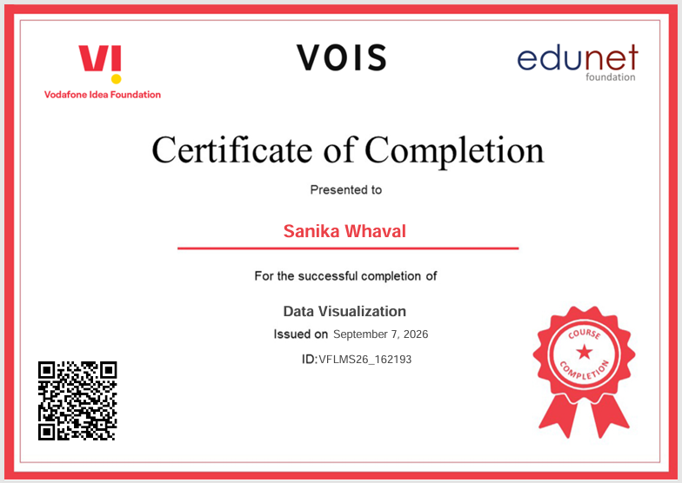
VOIS Course completion certificate - Course name- Data Visualization

Slide 14
Thank you
.
.

